Slide 1
AWS (Amazon Web Services) – Load Balancer

Slide 2
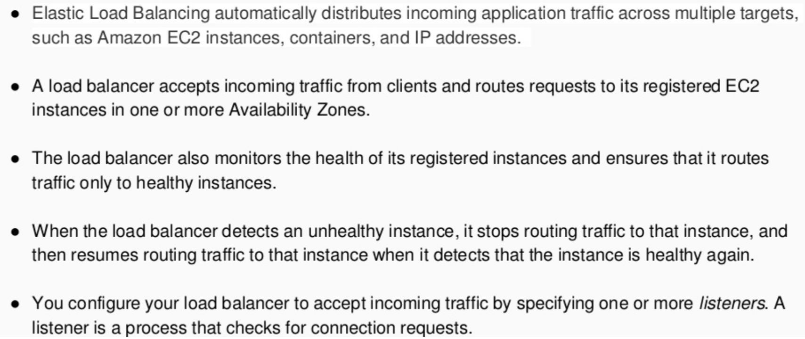
ELB – Elastic Load Balancer

Slide 3
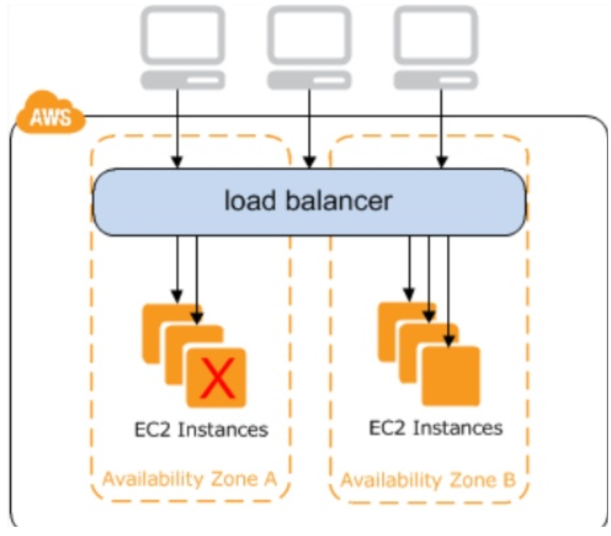
ELB – Elastic Load Balancer

Slide 4
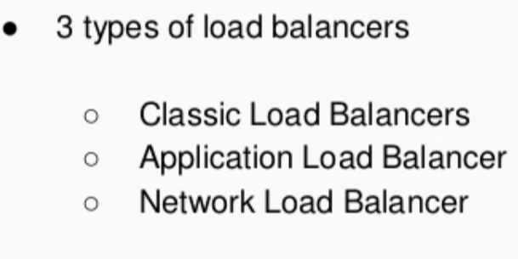
ELB – Elastic Load Balancer
ELB

Slide 5
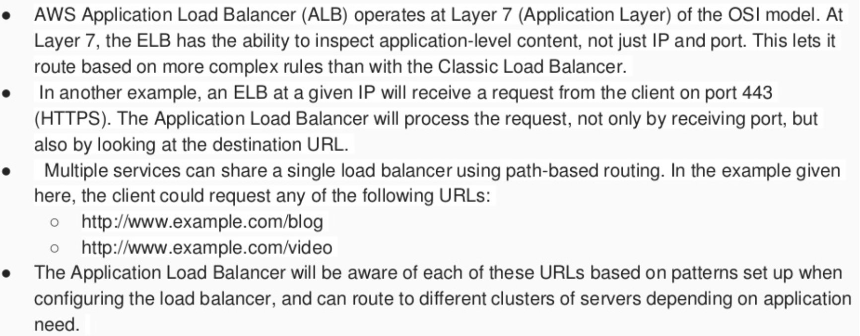
ELB – Elastic Load Balancer
Application Load Balancer (ALB)

Slide 6
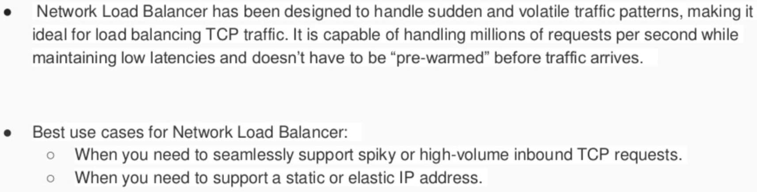
ELB – Elastic Load Balancer
Network Load Balancer (NLB)

Slide 7
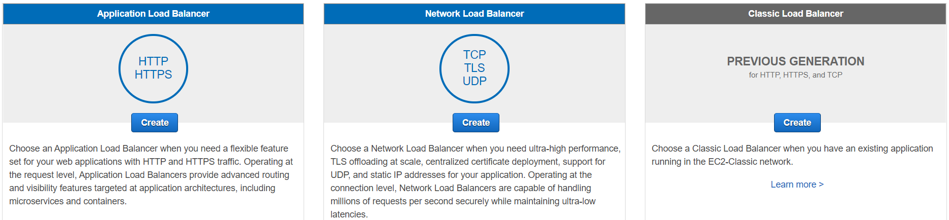
ELB – Elastic Load Balancer

Slide 8

Queries & Answers
Any Queries ??

